Slide 1
Nyaya Sahayak – AI Legal Intelligence System
AI-Based Legal Section Retrieval & FIR Generation
Team Members:
Harsh Pahariya (22BCE9130)
Kshitij Raj (22BCE7729)

Slide 2
Problem Statement
Identification of relevant legal sections is currently manual and time-consuming
Law enforcement officers must search through 889 legal provisions
High probability of missing important sections
FIR drafting requires legal expertise and experience
The process is slow, inefficient, and error-prone

Slide 3
Motivation
Increasing need for automation in legal systems
Reduce dependency on human expertise
Enable faster decision-making in critical situations
Improve accuracy and consistency
Provide a smart assistant for law enforcement officers

Slide 4
Objectives
Develop an AI-powered system for legal section retrieval
Support both BNS and CrPC laws
Provide dual input modes:
Free-text complaint input
Structured form-based input
Automatically generate FIR documents
Classify legal sections based on severity levels
Provide real-time complaint preview

Slide 5
Key Features
AI-Based Semantic Search
Understands meaning, not just keywords
Dual Input System
Text input for flexibility
Structured form for guided input
Real-Time Complaint Preview
Shows formatted complaint instantly

Slide 6
Severity Classification
High, Medium, Low categories
Automated FIR Generation
Based on BNS format
Balanced Retrieval Algorithm
Ensures:
5 BNS sections
3 CrPC sections
Improves legal coverage and reliability

Slide 7
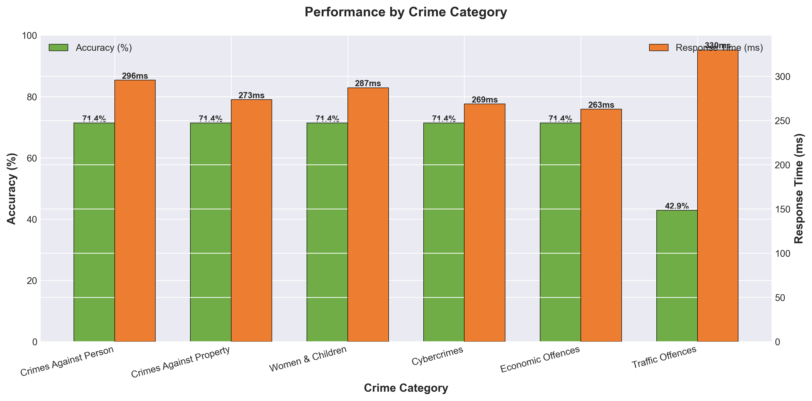
Performance by Crime Category
Observations:
Most crime categories achieve ~71.4% accuracy
Traffic-related offences show lower accuracy (42.9%)
Response time remains consistent across categories
Inference:
System performs reliably across domains
Some categories require further tuning

Slide 8
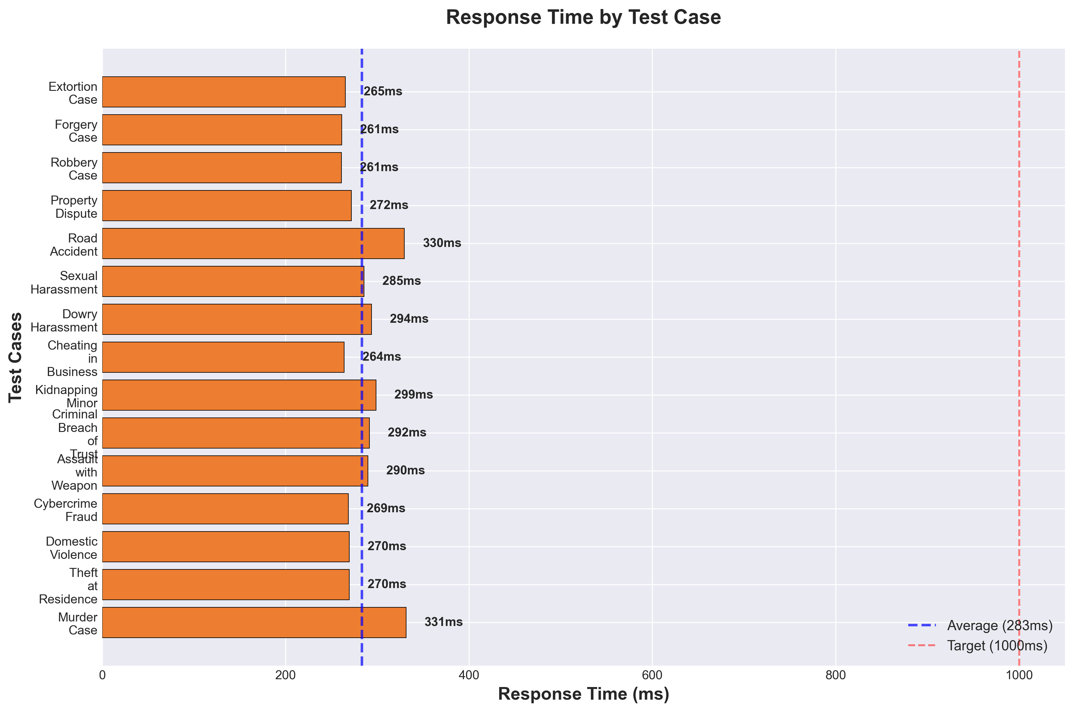
Response Time Analysis
Observations:
Average response time: 283 ms
Minimum: ~261 ms
Maximum: ~331 ms
Inference:
System operates within real-time constraints
Suitable for practical deployment

Slide 9
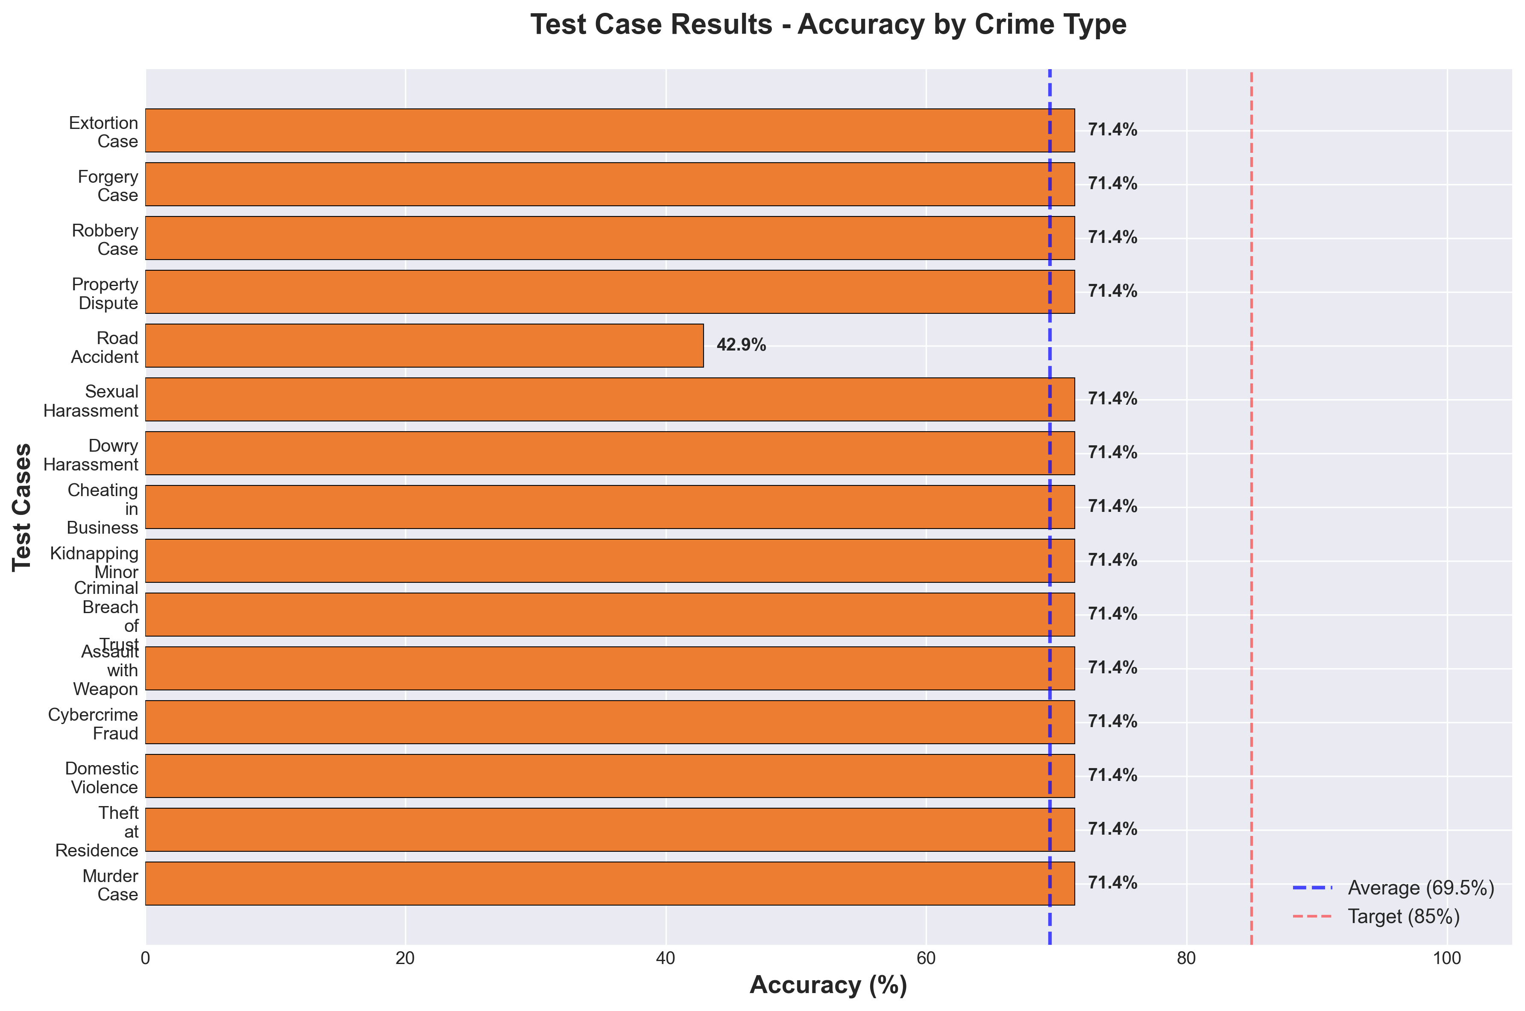
Accuracy Analysis
Observations:
Majority of test cases show consistent accuracy (~71.4%)
One edge case (road accident) shows lower accuracy
Indicates stable but improvable performance

Slide 10
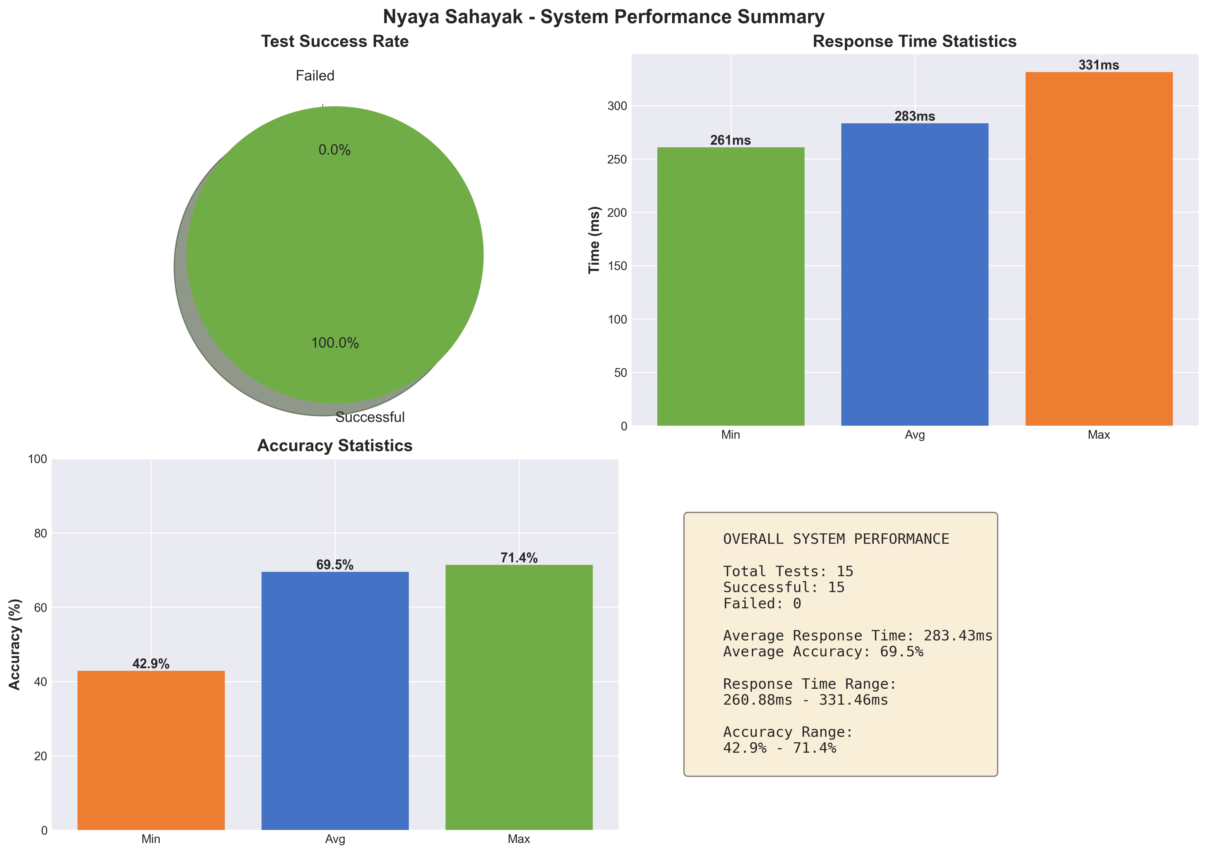
System Performance Summary
From test data :
Total Test Cases: 15
Successful Cases: 15 (100%)
Average Accuracy: 69.5%
Average Response Time: 283 ms
Key Insight:
System is stable, reliable, and consistent

Slide 11
Originality & Analytical Approach
Original Contributions:
Dual input system (text + structured form)
Real-time complaint preview
Balanced legal retrieval algorithm
BNSS 2023 compliance
Analytical Approach:
Uses RAG (Retrieval-Augmented Generation)
Semantic similarity via vector embeddings
Cosine similarity for matching
Separate handling of BNS and CrPC

Slide 12
Challenges, Conclusion & Future Scope
Challenges:
Data imbalance across categories
Parsing issues in legal text
Lower accuracy in edge cases
Conclusion:
Successfully built an AI-based legal assistant
Achieved 69.5% accuracy
Achieved sub-300ms response time
Demonstrated real-world applicability
Future Scope:
Multi-language support
Voice-based complaint input
Mobile application
Integration with real legal databases

